Slide 1


System Calls en Python
Réalisé par:Achraf Chliyah
Encadré par: Khalid Amechnoue

Slide 2
Outline
Introduction
System Calls definition
Various System Calls in Python
Conclusion

Slide 3
Introduction
Python is an interpreted high-level general-purpose programming language. Its design philosophy emphasizes code readability with its use of significant indentation. Its language constructs as well as its object-oriented approach aim to help programmers write clear, logical code for small and large-scale projects
os - Miscellaneous operating system interfaces: This module provides a portable way of using operating system dependent functionality

Slide 4
System Calls definition
a system call is the programmatic way in which a computer program requests a service from the kernel of the operating system on which it is executed. This may include hardware-related services (for example, accessing a hard disk drive or accessing the device's camera), creation and execution of new processes, and communication with integral kernel services such as process scheduling. System calls provide an essential interface between a process and the operating system.

Slide 5
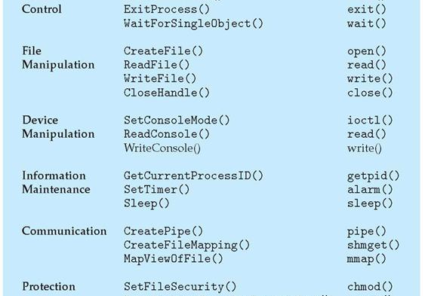
Various System Calls in Python

Slide 6
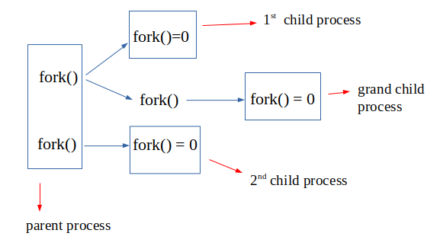
os.fork()
Fork a child process. Return 0 in the child and the child’s process id in the parent. If an error occurs OSError is raised.

Slide 7
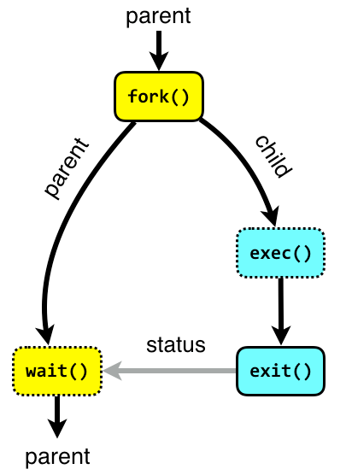
os.wait()
Wait for completion of a child process, and return a tuple containing its pid and exit status indication: a 16-bit number, whose low byte is the signal number that killed the process, and whose high byte is the exit status (if the signal number is zero); the high bit of the low byte is set if a core file was produced.

Slide 8
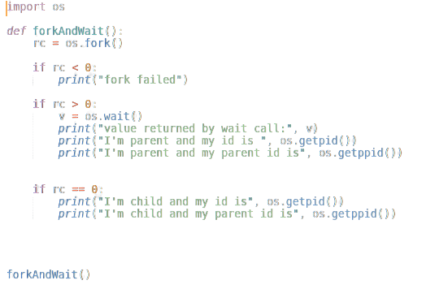
os.getpid() & os.getppid()
os.getpid() Return the current process id.
os.getppid() Return the parent’s process id. When the parent process has exited, on Unix the id returned is the one of the init process (1), on Windows it is still the same id, which may be already reused by another process.

Slide 9
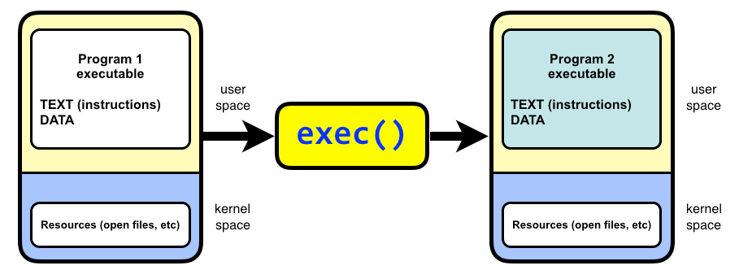
os.exec() family
These functions all execute a new program, replacing the current process; they do not return. On Unix, the new executable is loaded into the current process, and will have the same process id as the caller. Errors will be reported as OSError exceptions.
os.execl(path, arg0, arg1, ...)
os.execle(path, arg0, arg1, ..., env)
os.execlp(file, arg0, arg1, ...)
os.execlpe(file, arg0, arg1, ..., env)
os.execv(path, args)
os.execve(path, args, env)
os.execvp(file, args)
os.execvpe(file, args, env)

Slide 10
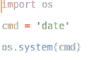
os.system(cmd)
Execute the command (a string) in a subshell. This is implemented by calling the Standard C function system(), and has the same limitations.

Slide 11
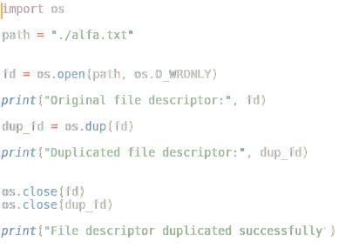
os.dup(fd) & os.dup2(fd, fd2, inheritable=True)
os.dup() Return a duplicate of file descriptor fd. The new file descriptor is non-inheritable
os.dup2() duplicate file descriptor fd to fd2, closing the latter first if necessary. Return fd2. The new file descriptor is inheritable by default or non-inheritable if inheritable is False.

Slide 12
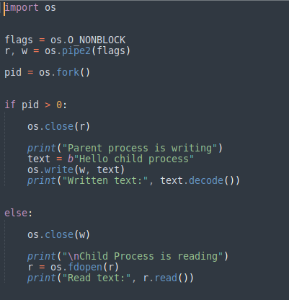
os.pipe() & os.pipe2(flags)
os.pipe() Create a pipe. Return a pair of file descriptors (r, w) usable for reading and writing, respectively. The new file descriptor is non-inheritable.
os.pipe2() Create a pipe with flags set atomically. flags can be constructed by ORing together one or more of these values: O_NONBLOCK, O_CLOEXEC. Return a pair of file descriptors (r, w) usable for reading and writing, respectively.

Slide 13
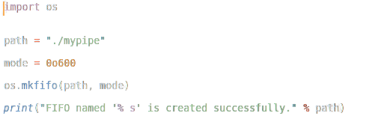
os.mkfifo(path, mode=438, *, dir_fd=None)
Create a FIFO (a named pipe) named path with numeric mode mode. The current umask value is first masked out from the mode.

Slide 14
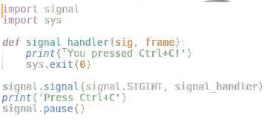
signal.signal(signalnum, handler)
Set the handler for signal signalnum to the function handler. handler can be a callable Python object taking two arguments ,or one of the special values signal.SIG_IGN or signal.SIG_DFL

Slide 15
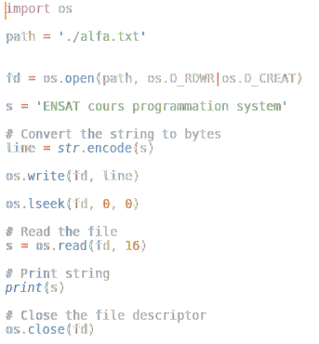
os.lseek(fd, pos, how)
Set the current position of file descriptor fd to position pos, modified by how: SEEK_SET or 0 to set the position relative to the beginning of the file; SEEK_CUR or 1 to set it relative to the current position; SEEK_END or 2 to set it relative to the end of the file. Return the new cursor position in bytes, starting from the beginning.

Slide 16
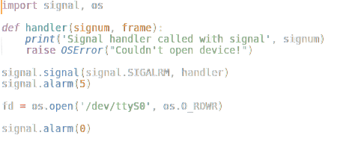
signal.alarm(time)
if time is non-zero, this function requests that a SIGALRM signal be sent to the process in time seconds. Any previously scheduled alarm is canceled (only one alarm can be scheduled at any time). The returned value is then the number of seconds before any previously set alarm was to have been delivered. If time is zero, no alarm is scheduled, and any scheduled alarm is canceled. If the return value is zero, no alarm is currently scheduled.

Slide 17
os.kill(pid,sig)
Send signal sig to the process pid. Constants for the specific signals available on the host platform are defined in the signal module.

Slide 18
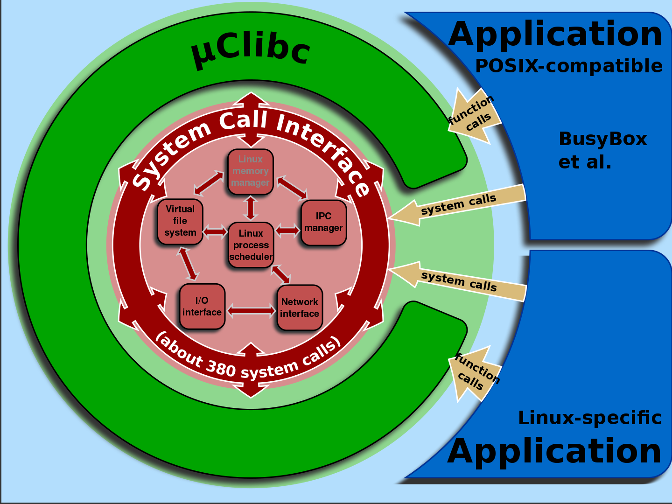
Conclusion
System calls are an important API for user space code to execute privileged kernel actions. Calling a system call from user space involves adding the correct arguments to registers, and trapping into the kernel. Normally this is taken care of by functions in the C library.

Slide 19

Merci !

